Slide 1
DDCO MINI PROJECT
Constructing a simple CPU using logisim simulator

Slide 2
logisim
Logisim is an educational tool for designing and simulating digital logic circuits. With its simple toolbar interface and simulation of circuits as you build them, it is simple enough to facilitate learning the most basic concepts related to logic circuits. With the capacity to build larger circuits from smaller subcircuits, and to draw bundles of wires with a single mouse drag

Slide 3
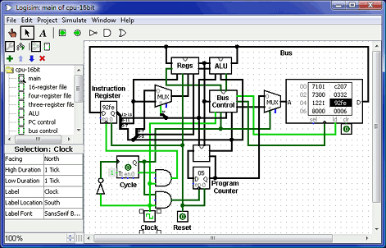
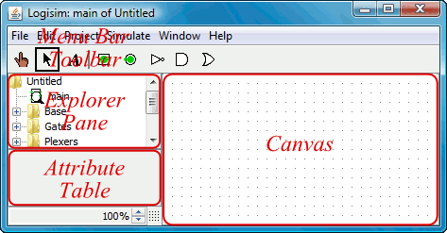

Slide 4
SIMPLE CPU
THE 4-BIT CPU CONSITS OF THREE PARTS
REGISTER FILE
ALU
DATAPATH

Slide 5
REGISTER FILE
THE REGISTER FILE IS A COLLECTION OF REGISTER IN WHICH THE INFORMATION IN STORED AFTER OR BEFORE THE DATA ARE FED TO THE ALU.
IT CONSITS OF ‘DATAIN’, ‘LOAD’, ‘ A ADDRESS’, ‘ CLK’, ‘ 8 -4BIT SERIAL SHIFT REGISTER, ‘ ADDRESS A’, ‘ ADDRESS B’, ‘ADDRESS Aout’, ‘ADDRESS Bout’ .

Slide 6
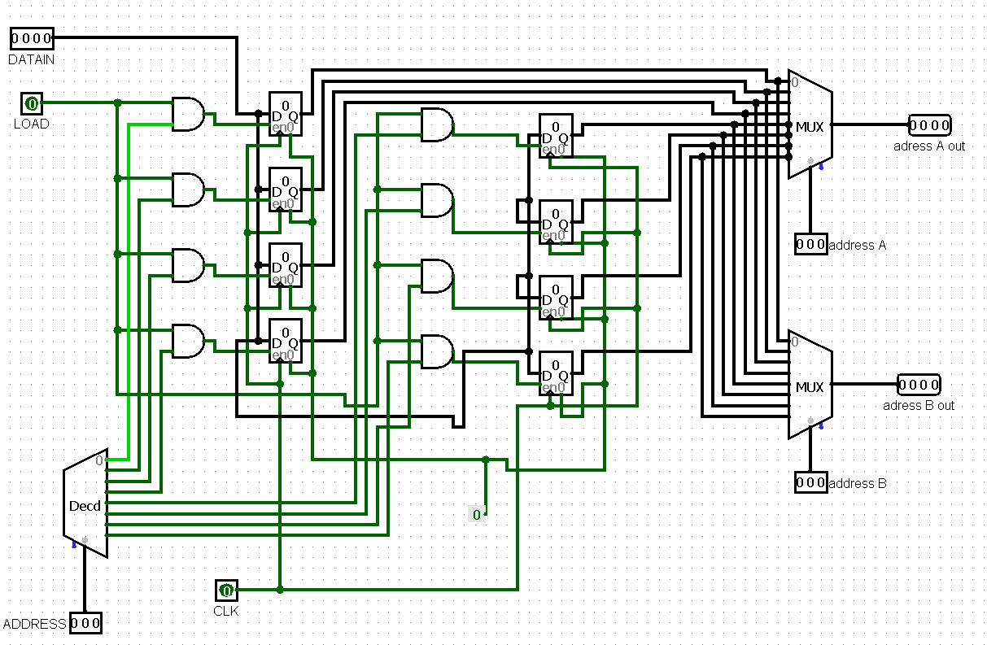
REGISTER FILES
COMPONENTS USED:
8 AND GATED.
3-8 LINE DECODER.
8-4BIT SERIAL SHIFT REGISTER.
2 8:3 MUX.

Slide 7
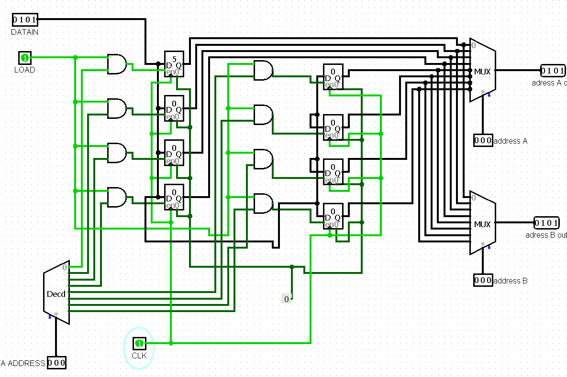
REGISTER FILE
BASIC WORKING:
consider we want to load a number 5(0101) to a register Ro.
DATAIN is set to 0101
Now to load the data to register Ro we set the
A ADDRESS to 0000 this selects the register Ro.
The load and cloak is enabled simultaneously thus
pushing the data 0101 to register Ro serially
The load is disabled and the cloaks are disabled.

Slide 8
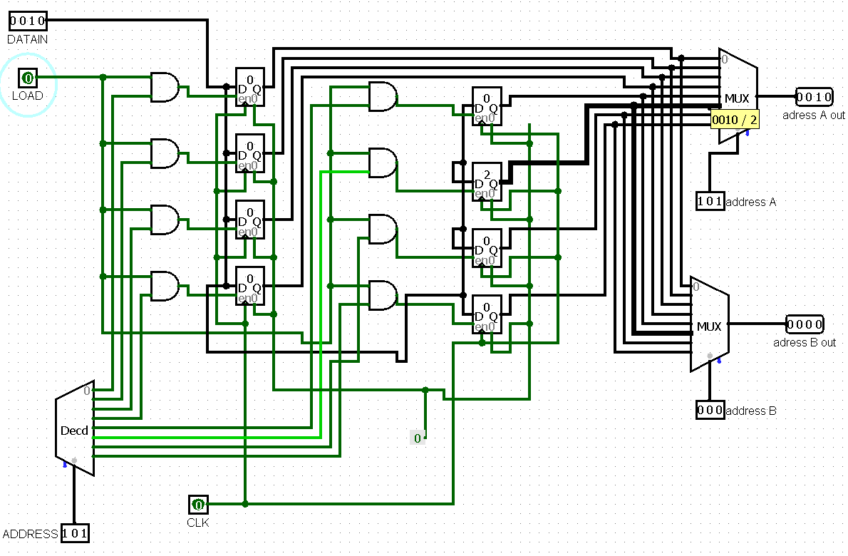
REGISTER FILE
Consider we want to load the data of the register R5 to the output line
Assuming that the data is already loaded in the register R5.
In order to obtain the output on the address Aout the address of the register R5 is specified in the address A of the multiplexer A .
Thus the output is obtained in the address Aout

Slide 9
REGISTER FILE
DATAIN | LOAD | CLK | A ADDRESS | REGISTER | ADDRESS A | ADDRESS B | ADDRESS A OUT | ADDRESS B OUT
5(0101) | 1 | 1 | [R0]=0000 | R0=>5(0101) | X | X | X | X
X | X | X | X | R5=>2(0010) | [R5]=0101 | X | 2(0010) | X
3(0011) | 1 | 1 | [R3]=0011 | R3=>3(0011) | X | X | X | X
X | X | X | X | R2=>2(0011) | X | [R2]=0010 | X | 2(0010)

Slide 10
ALU
An arithmetic logic unit (ALU) is a combinational digital electronic circuit that performs arithmetic and bitwise operations on integer binary numbers.
An ALU is a fundamental building block of many types of computing circuits, including the central processing unit (CPU) of computers.

Slide 11
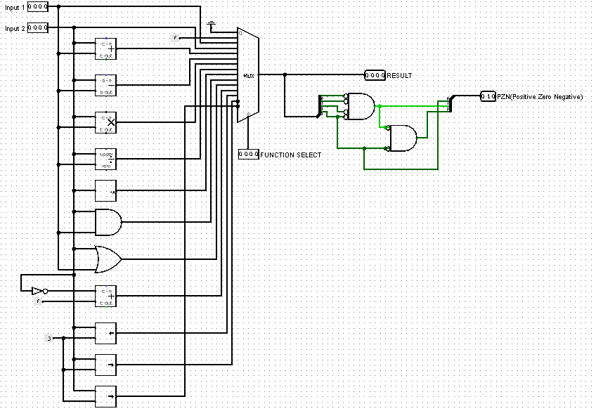
alu
Components used:
2 4-bit input pins
1 Full adder
1 Subtarctor
1 Multiplier
1 Divider
1 Shift right register
1 Shift left register
1 AND gate
1 NOT gate
1 Negator
1 16:1 MUX
1 4-input NOR gate
1 2-input NOR gate

Slide 12
ALU
Basic working:
The numbers get loaded in the two output pins.
The operation to be performed is selected by the control unit and that output is selected from the MUX.
The output pin shows the output of the operation performed whereas the PZN pin shows the sign of the result.

Slide 13
ALU
Select lines to choose the desired operation:
0000 is Ground
0001 is Constant Number
0010 is Input 1
0011 is Input 2
0100 is Add
0101 is Subtract
0110 is Multiply
0111 is Divide
1000 is Negation
1001 is Bitwise AND
1010 is Bitwise OR
1011 is 2’s compliment of input 2
1100 is Shift right
1101 is Shift left
1110 is Arithmetic Right

Slide 14
DATAPATH
A Datapath is a collection of functional units such as the Arithmetic Logic Unit(ALU) that performs data processing operations, the Register File, for storage of data, registers , and buses.[
” All computers have a CPU that can be divided into two pieces. The first is the datapath, which is a network of storage units (registers) and arithmetic and logic units... connected by buses... where the timing is controlled by clocks.” - The Essentials of Computer Organization and Architecture by Null & Lobur

Slide 15
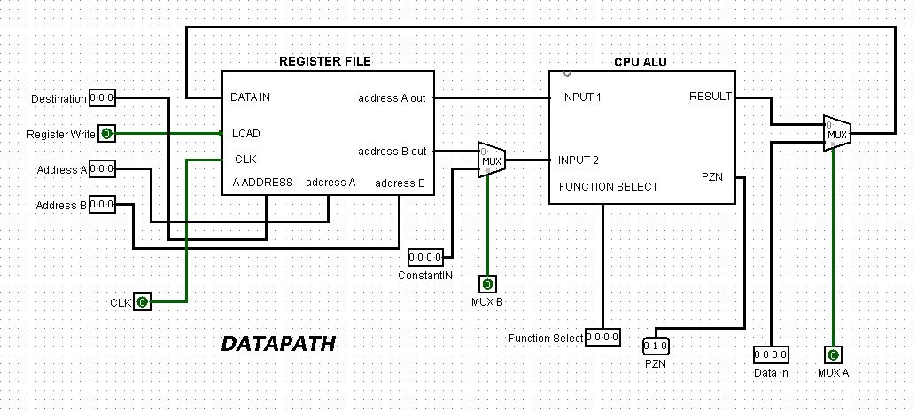
The circuit
The components of our Datapath are:
4-bit Arithmetic Logic Unit
Register File
2:1 multiplexer for choosing between a constant or output of Register File
2:1 multiplexer for choosing between a data input or result output of the ALU
Various inputs and connecting buses

Slide 16
Working of the datapath
Working
A destination address, Address A and Address B is inputed, with a Register Write high signal
A suitable select signal is given to the MUX to select either a Data input or Address output of Register File
The output of MUX is given to the ALU as an input to perform operations as per the input given through the Function Select.
The output result passes to another MUX through which it can be sent to the Data In of the Register File
The PZN output displays if the output is Positive, Zero or Negative.

